Slide 1

Introduction to Explorations
Year 10
Lesson 5 & 6 Values &
Perspectives

Slide 2

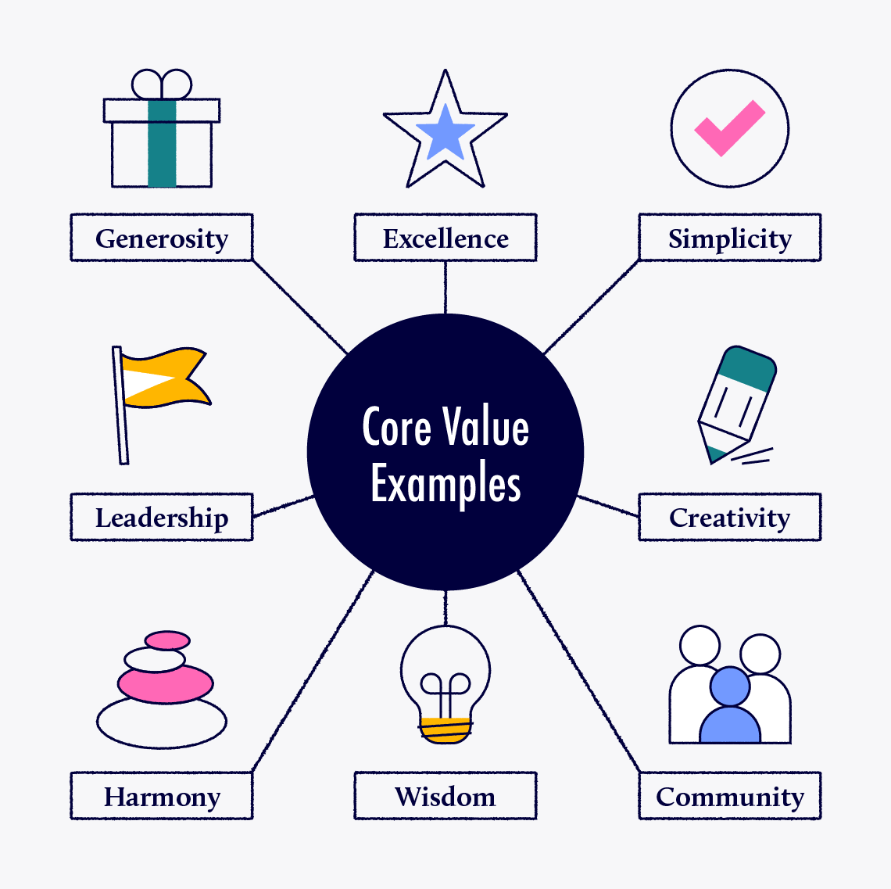
Values vs Perspectives
What is a Value?
Definition: A core standard or belief about what is important, good, or desirable.
Function: Acts as an inner compass that guides your choices, priorities, and moral judgments.
Stability: Highly stable and slow to change over time.
Global competency skill development: Critical thinking - I am skilled at looking at topics from different points of views

Slide 3
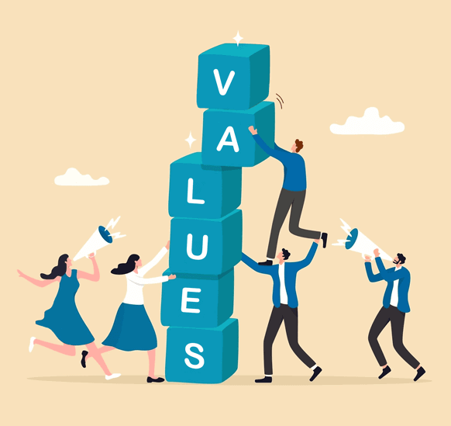
What do you value more?
Review this list of values and their brief definitions. Sort the values into an order according to their relative importance to you.
Place those values that are most important to you at the top and the least at the bottom.
Answer the follow up questions before we share what we have learned with the class.
Global competency skill development: Critical thinking - I am skilled at looking at topics from different points of views

Slide 4
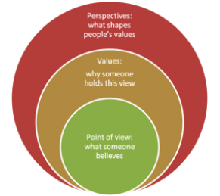
Values vs Perspectives
What is a Perspective?
Definition: An overall viewpoint, angle, or framework used to look at a specific situation or topic.
Function: Shapes how you process information, understand experiences, and form opinions based on your current context or role.
Stability: Flexible; it can change quickly if your circumstances, role, or information change.
Global competency skill development: Critical thinking - I am skilled at looking at topics from different points of views

Slide 5
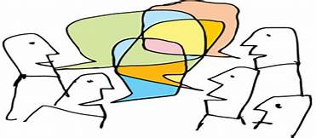
Factors Influencing Perspectives
Different viewpoints/perspectives about world and local issues are influenced by a wide range of factors.
In Explorations you need be able to identify and analyse different perspectives.
How do your views and perspectives compare to other people in the world?
Global competency skill development: Critical thinking - I am skilled at looking at topics from different points of views

Slide 6
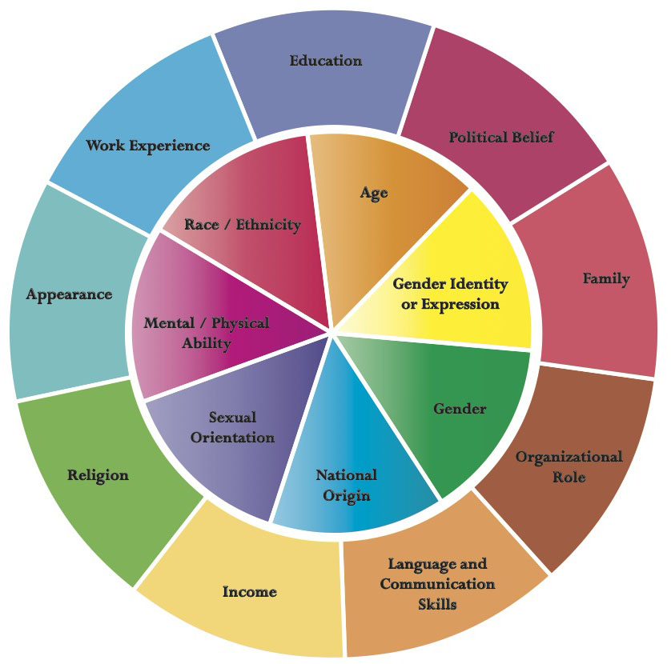
Factors Influencing Perspectives:
Explain how 3 of these factors might influence someone's’ perspectives on your issue?
Complete your own identity wheel in your booklet.
How might your views on an issue be influenced by your identity? Eg. does your religion or family background make you think about issues in a certain way?

Slide 7

Contrasting Perspectives on your issue
Identify 2 contrasting perspectives from your research that give different views on your topic.
What do these different views tell us about the causes, consequences or solutions to the issue?
Name and find a picture of the stakeholders the cite a quote about what they say about this issue in your resource booklet.
Record this in your planning document
Global competency skill development: Critical thinking - I am skilled at looking at topics from different points of views

Slide 8
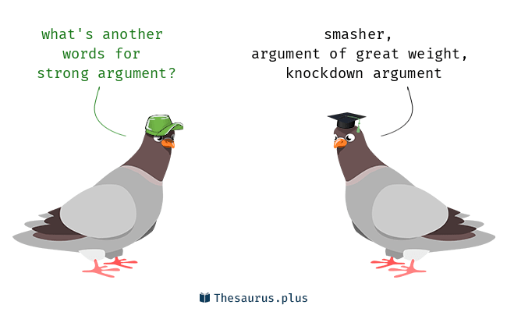
What Makes a Strong Argument?
Think about the following factors- discuss this as a group and class - are there any examples of this in the research you have done so far?
Language | Evidence | Clarity
Reasoning | Clarity | Structure/Balance
Write 2 or 3 examples of strong arguments or weak arguments in your booklet/ presentation based on a research article you have used so far.

Slide 9
Introduction to Explorations
Year 10
Lesson 7 Information Literacy

Slide 10
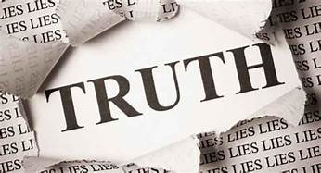
Information Literacy
In the next lesson you will be asked to consider the reliability of the information you have collected so far and evaluate the reliability of the sources you have used.
…..But first let’s have a look at a range of factors that influence the reliability media and tools that can enable us to evaluate the reliability of sources of information.
Global competency skill development: Critical thinking - I understand when information is trustworthy and when it isn’t

Slide 11
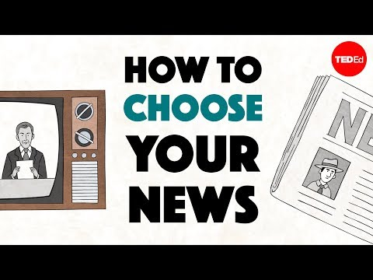
How to choose your news?
Notes:
https://www.youtube.com/results?search_query=how+to+choose+your+news

Slide 12
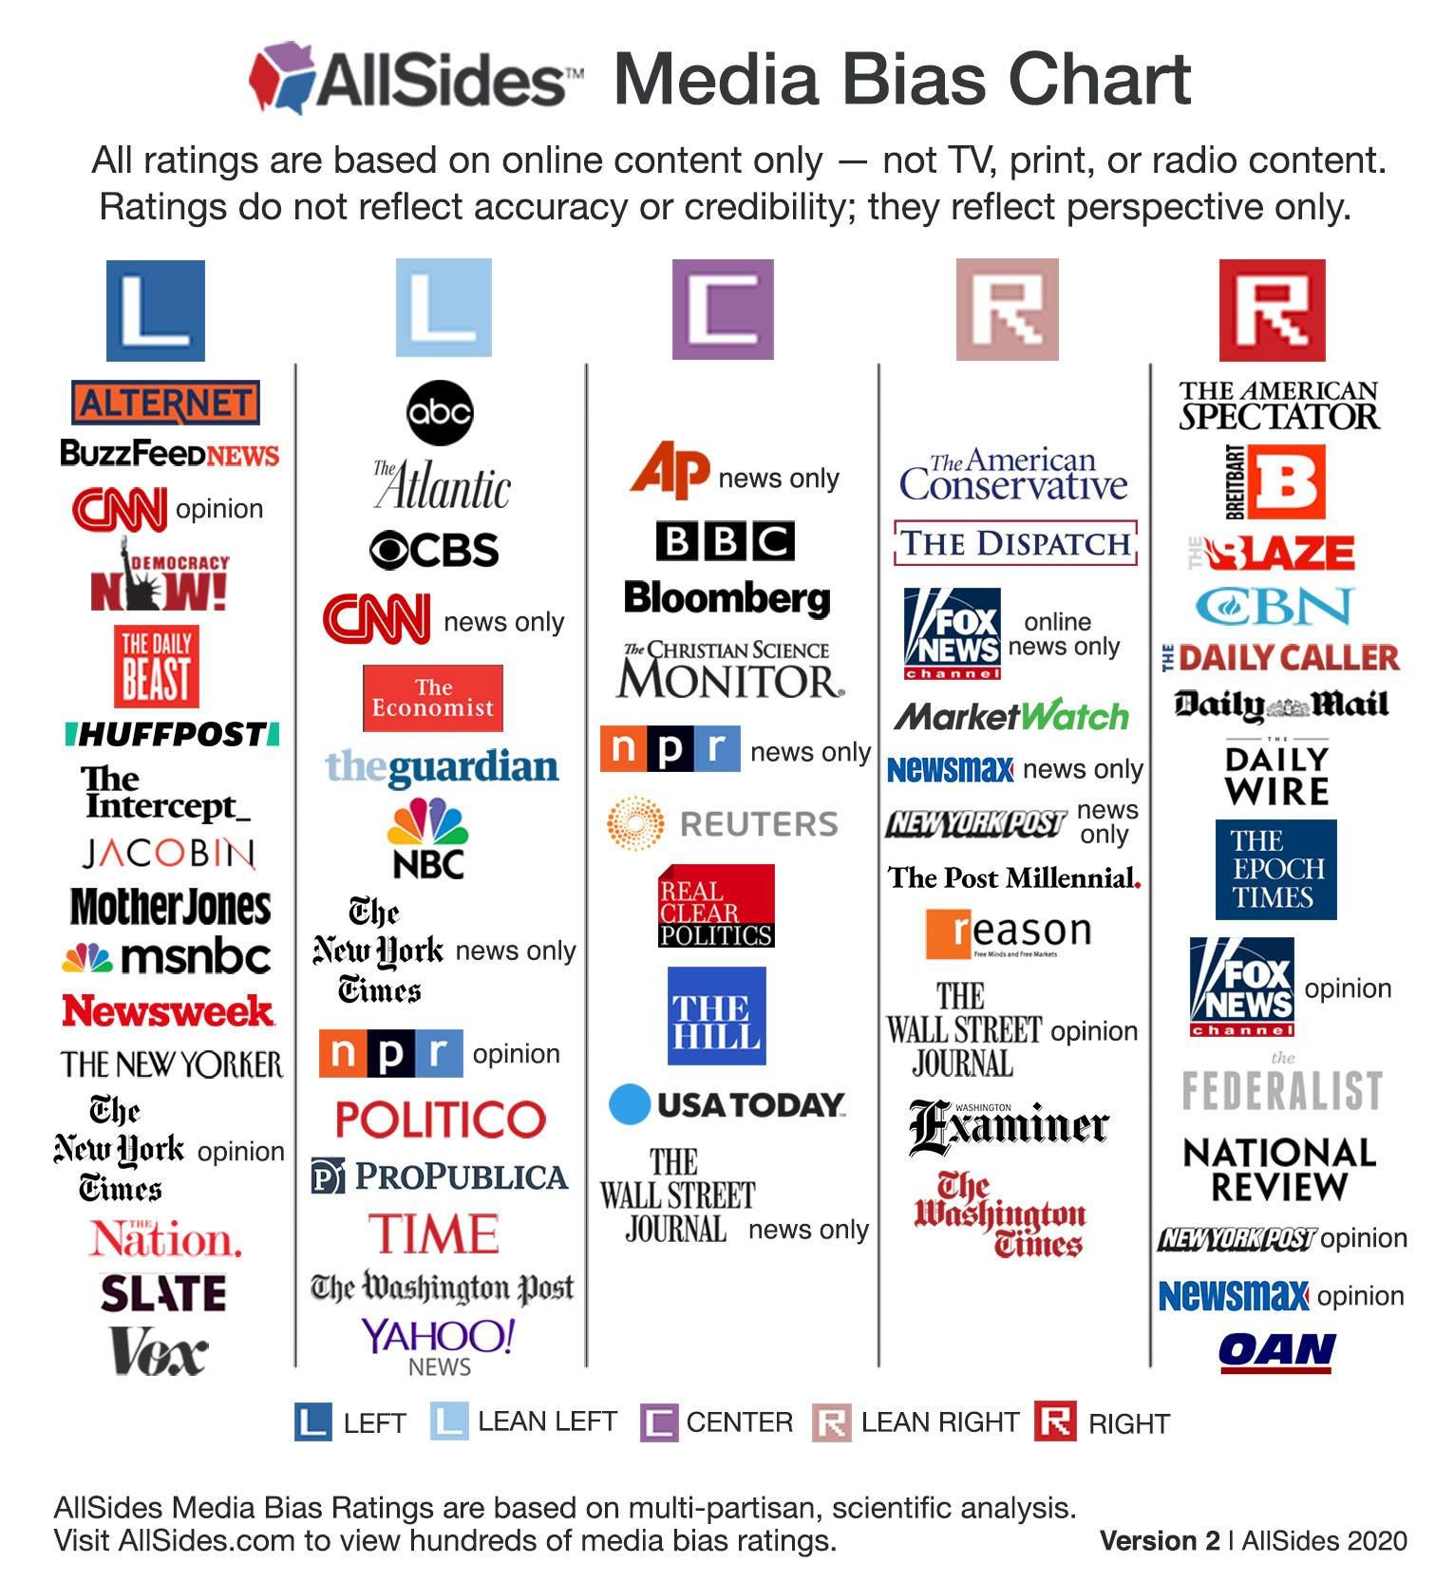
news bias?
Different news media are sometimes viewed as being biased towards the left and right of politics
Some news organisations are seen as biased towards the Left- more socialist liberal views
Some organisations are biased towards the right more conservative traditional views
This is a useful tool:
website-bias fact check

Slide 13
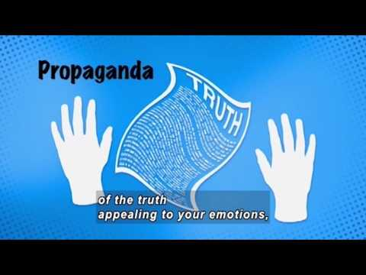
Influence of the internet?
How do we know if something is true?
Bias
Fact
Value judgement
Propaganda
Credibility
Opinion
Vested interest
Gossip
Hype
Predictions
Global competency skill development: Critical thinking - I understand when information is trustworthy and when it isn’t

Slide 14
Origin of Websites
.edu - education sites
.gov - government sites
.org - organization sites
.com - commercial sites
.net - network infrastructures
Different websites are written by different organisations for different purposes.
Being aware of the source of your research is an important skill in Global Perspectives.
Different websites may reflect different opinions, interests, values and biases.

Slide 15
Is there bias in the media?
Optional Activity- Bias in the news- Read this article
Choose one or two of the following aspects of bias and be prepared to explain what they mean in a discussion
bias by selection or omission
bias through placement
bias by headline
bias by word choice
bias by use of names/titles
bias through statistics
bias by source control
Can you identify any examples in sources that you have come across so far? Use Ground News to help you with this.
Global competency skill development: Critical thinking - I understand when information is trustworthy and when it isn’t

Slide 16
IMPORTANT VOCABULARY
Opinion: generally defined as an individual’s point of view or belief which is not necessarily shared by others/supported by evidence.
Fact: something which can be checked or proved; something that is true and which can be verified from experience and observation; a piece of information.
Value Judgment: a particular type of opinion. It is a subjective assessment based on a code of values concerning what is right and wrong; a decision based on moral principles or beliefs; not based upon facts which can be checked or proved.
Bias: Inclination or prejudice for or against one person or group, especially in a way considered to be unfair.
Vested Interest: If you have a personal stake in something which causes you to be biased toward it, you have a vested interest in it.
Prediction: Generally defined as a statement suggesting something which is likely to happen in the future.

Slide 17

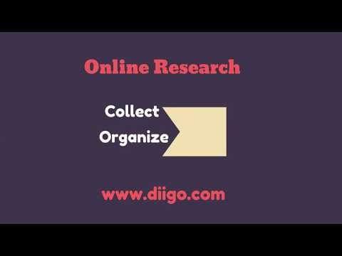
Identifying Opinions, facts, predictions, value judgements
Additional Task
For an online article you have used so far identify the following using the Diigo research annotation tool. This is a useful tool for bookmarking and annotating articles
Annotate the article to highlight examples of :
Facts
Predictions
Opinions
Value judgements
Share these examples with the class
https://www.diigo.com/

Slide 18
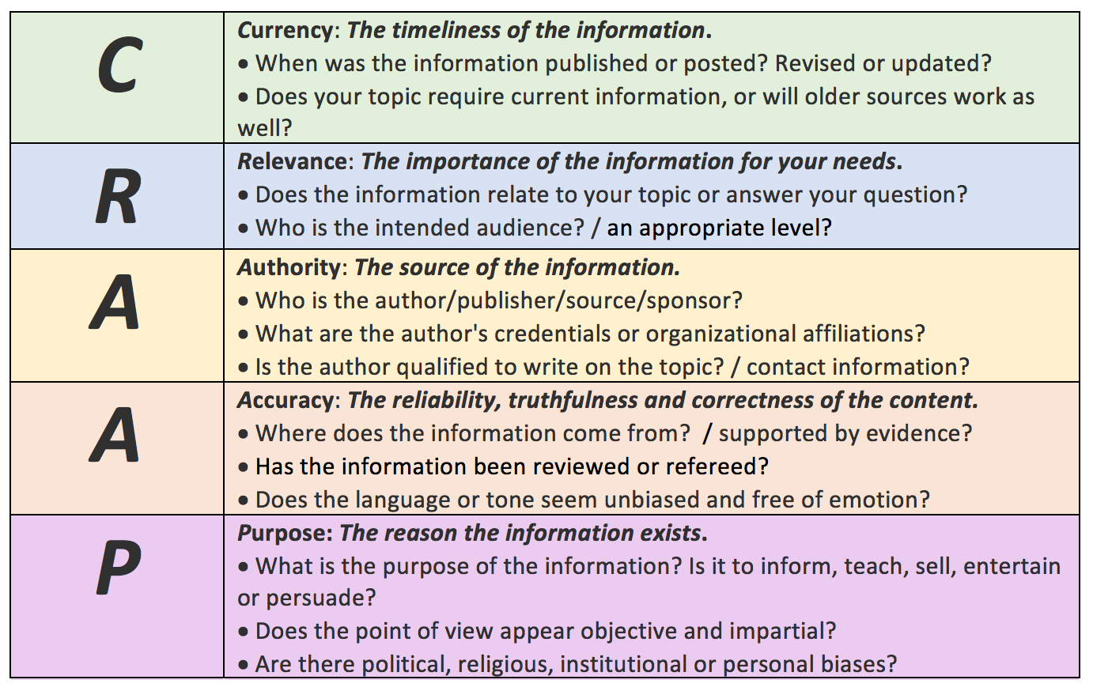
CRAAP Test- Evaluating sources
Remember from year 9? -The CRAAP test can be used as a way of evaluating a the reliability of a source/s.
This is a key skill in Global Perspectives and you will need to demonstrate this skill in assessments throughout the course.

Slide 19
Currency
Can you tell when the information was published?
Is the information up to date?
Are the links up to date and working?
Accuracy
Is it free from spelling errors?
Has the author included a bibliography?
Are the sources cited reliable and can they be verified elsewhere?
Relevance
Does the info. relate to your topic or answer your question?
Is the information at an appropriate level (i.e. not too elementary or advanced for your needs)?
Have you looked at a variety of sources before determining this is one you will use?
Purpose
Does the author present a variety of arguments and viewpoints?
Is it a personal website? Does it express personal opinions?
Is the website part of a commercial organisation, a political party or an organisation with a specific agenda? If yes, question the motives for publishing the information.
Does the website promote a biased viewpoint?
Authority
Is the author identified? If the author has chosen to remain anonymous, ask yourself 'why?'
Is the author a person you recognise as an expert in his field?
If not, is there enough information provided to establish the author’s credibility?
Can you find references to them elsewhere?
Is the author affiliated to an academic institution or credible organisation?
Does the sources have a reputation for impartiality or lack of bias?

Slide 20
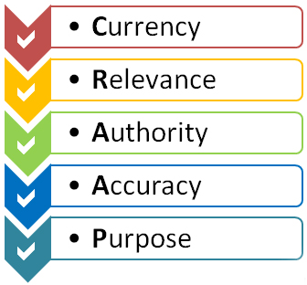
Complete a CRAAP analysis for 2 of the sources you have used in your research for your assessment
In your unit booklet complete a CRAAP test for at least 2 contrasting sources that you have used so far.
Record your analysis in your booklet- you don’t have to apply all the CRAAP aspects just two or three that are the most important
You will share this with this class at the end of the lesson today

Slide 21
CRAAP
Questions to consider:
Why is the currency or date of publication an important consideration?
Not all sources are created equal, how can credibility be understood in relation to journalists, newspapers or media organization?
Reliability, truthfulness, correctness and accuracy seem to be harder and harder to find, especially in political discourse. How does a reader seek to be correctly and accurately informed in 2026?
What ways does bias appear in media and how can students and researchers recognize it or avoid it?
How might teens or young adults speak with people who might be misinformed or under a false narrative?

Slide 22
